Slide 1
3D Image Segmentation and Quantification of Lysosomes
5/2/2025

Slide 2
AXONS

Slide 3
SCRIPT
Methods:
Automatic
  Intensity-aware bridging
  Shortest-path stitching
Manual
  Napari

Slide 4
AUTOMATIC METHODS
A) Intensity-aware bridging(straight bridge + intensity check)
Try to connect two nearby neurite endpoints with a candidate line/tube, only keep the bridge if most of the path stays bright (neurite-like) or reject bridges that pass through dark/background space.
If the pixels along that line are mostly bright (neurite-like) → accept the bridge.
If the line goes through dark background → reject it.
B) Shortest-path stitching in an intensity cost map
Instead of a straight line, search for a path between endpoints in a small region, make bright pixels “cheap” to pass and dark pixels “expensive.”
If a low-cost (bright-following) path exists, connect along it and helps follow curved neurites and avoids dark gaps.
Then ask: Is there a low-cost path between the two endpoints inside a small box?
If yes → connect along that curved path.
If the only possible path goes through dark pixels (high cost) → don’t connect.

Slide 5
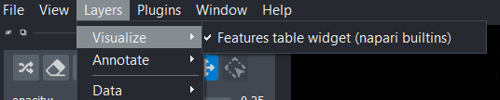
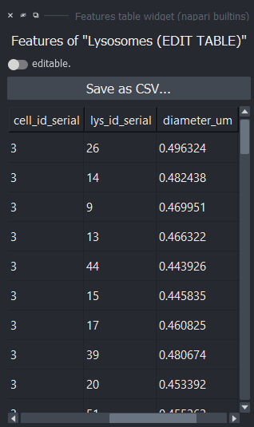
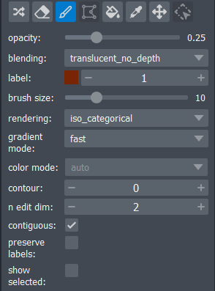
MANUAL METHOD
I use manual controls in Napari to join fragments of a branch and generate a dynamic dataset where I can modify the cell ID value where the lysosome is located and save the dataset with the change.

Slide 6
FILES:
-Airy scan_40A_UAS-TMEM-HA_axon_0h_again_2_051222
-Airy scan_40A_UAS-TMEM-HA_axon_0h_again_3_051222

Slide 7
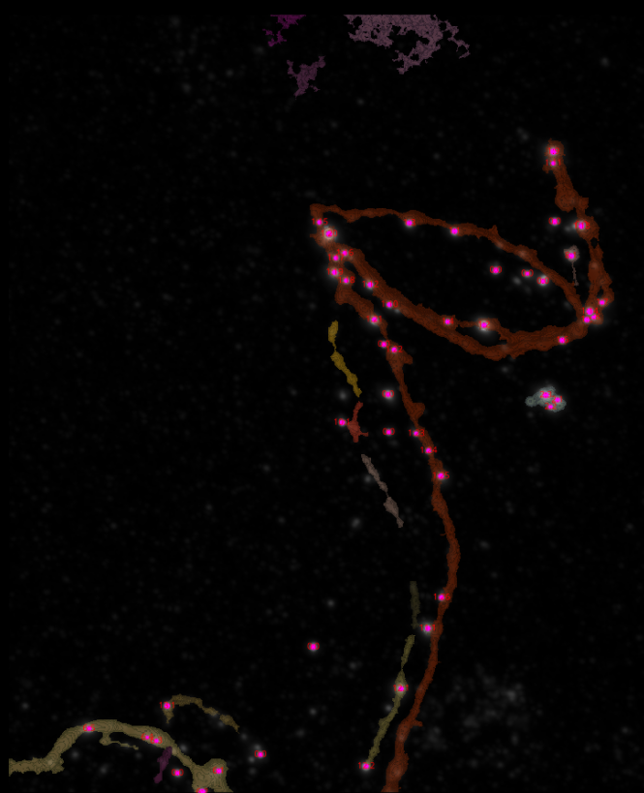
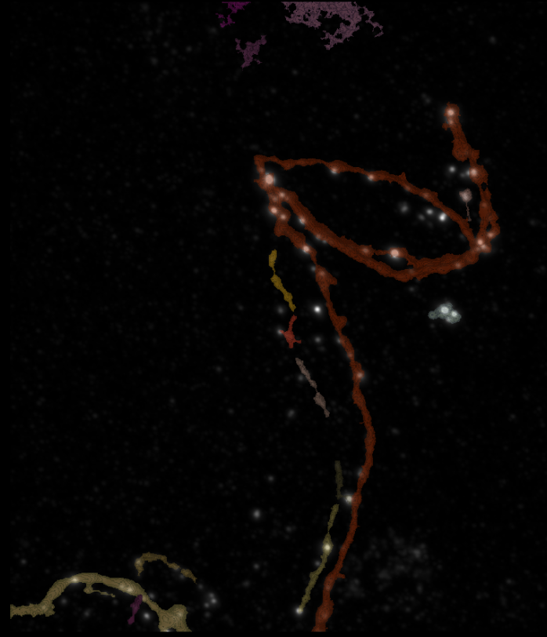
0H 2
Erosion = 4
Thresholding = 0.002
margin um = 0.5
overlap alpha = 0.4
viz min voxels = 2000
CLOSING = 6
max_gap_UM = 4

Slide 8
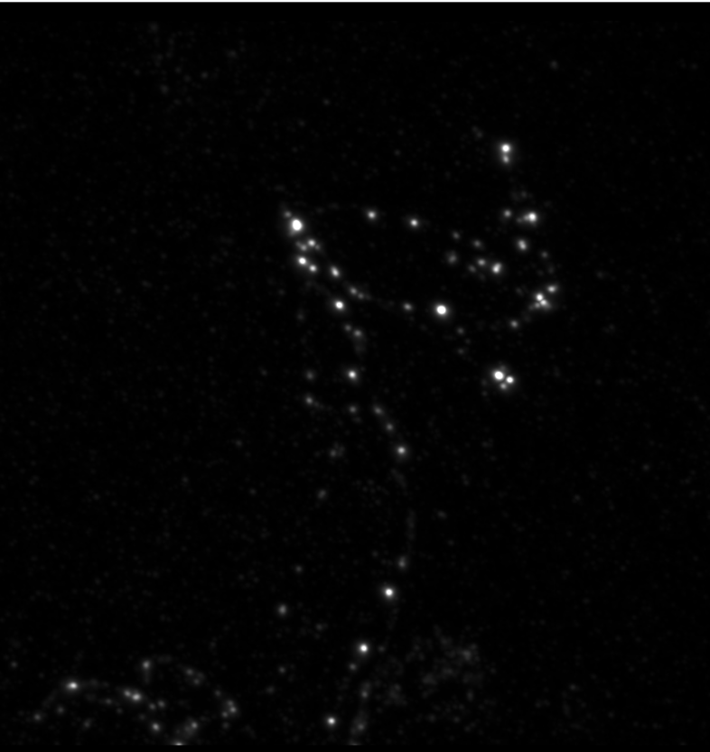
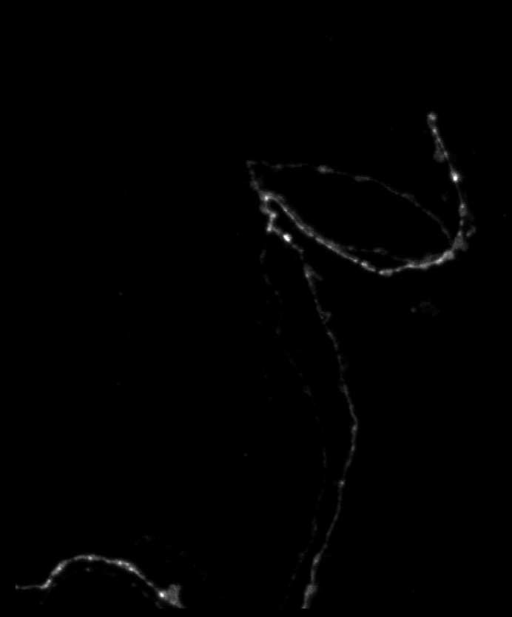
0H 2

Slide 9
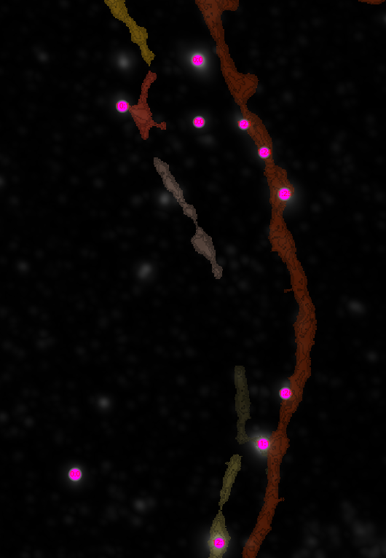
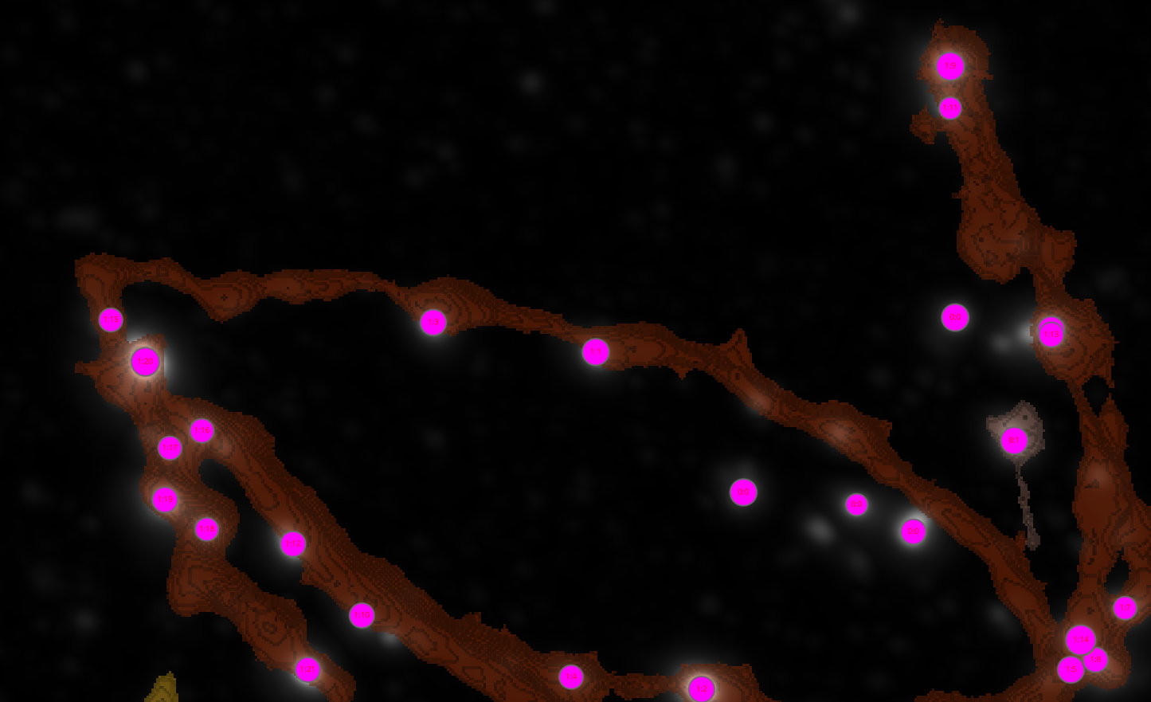
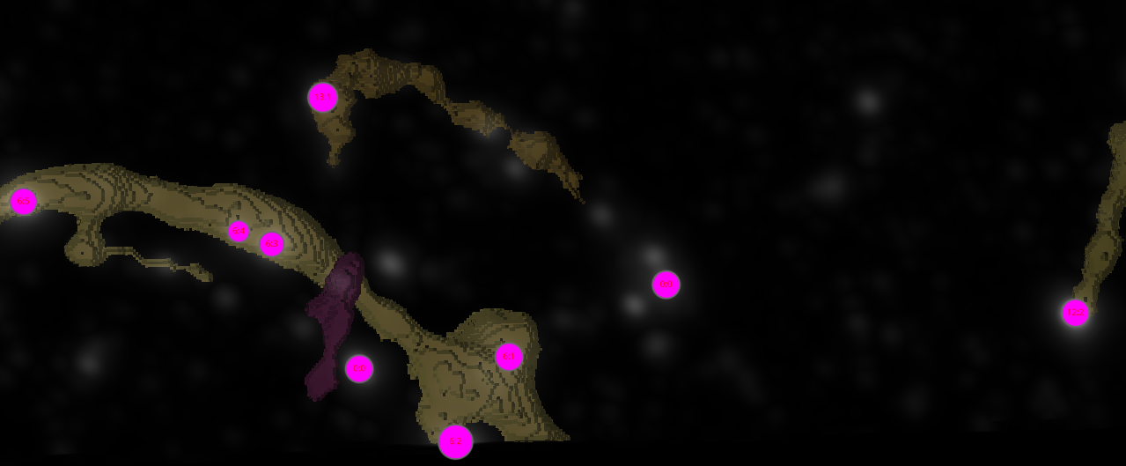
0H 2

Slide 10
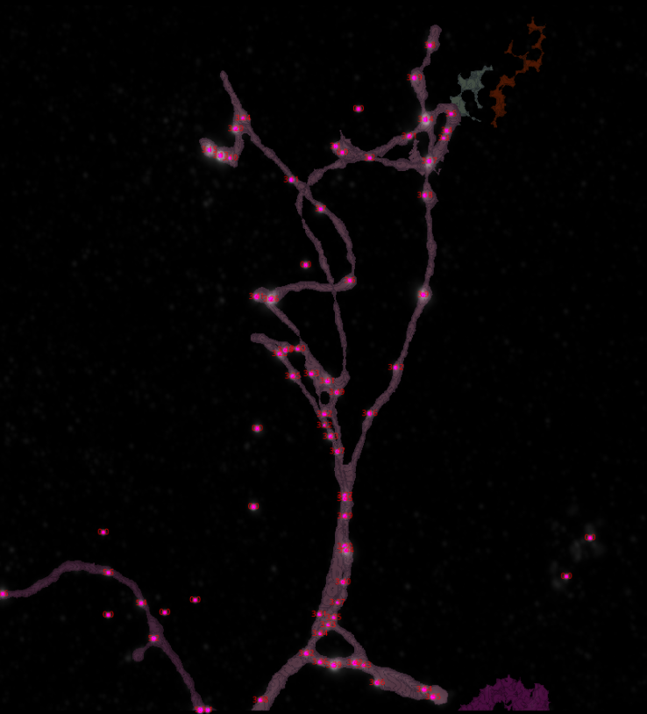
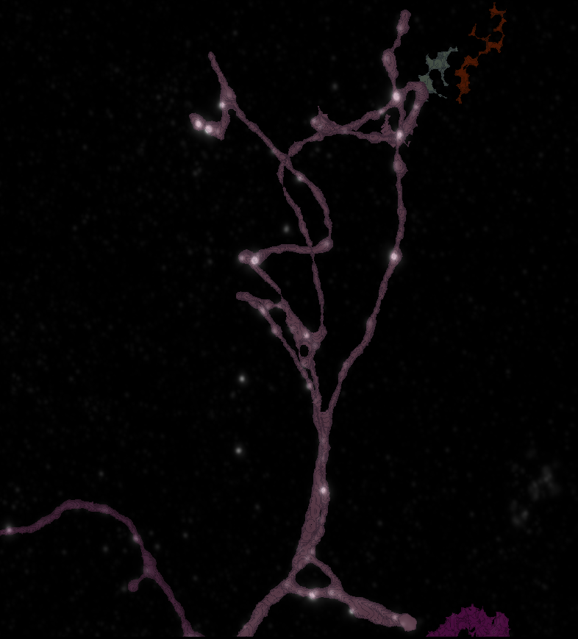
0H 3
Erosion = 4
Thresholding = 0.001
margin um = 0.5
overlap alpha = 0.4
viz min voxels = 2000
CLOSING = 9
max_gap_UM = 3

Slide 11
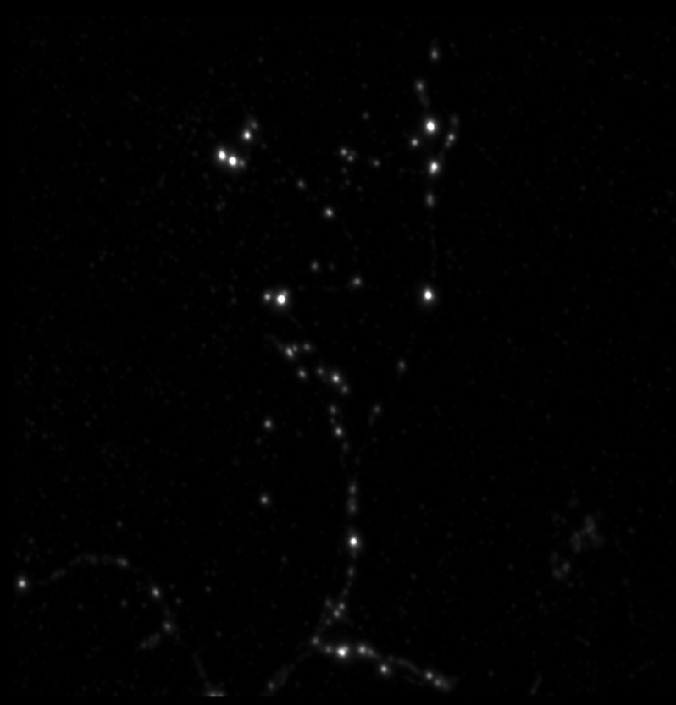
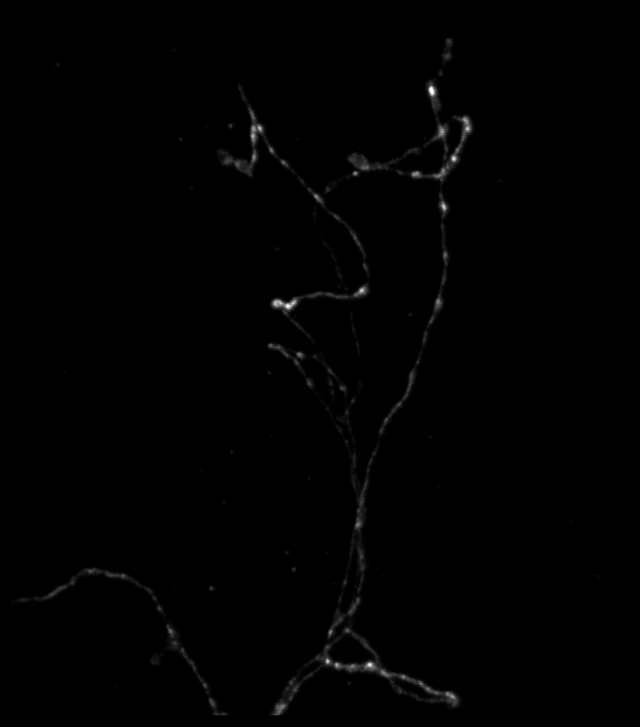
0H 3

Slide 12
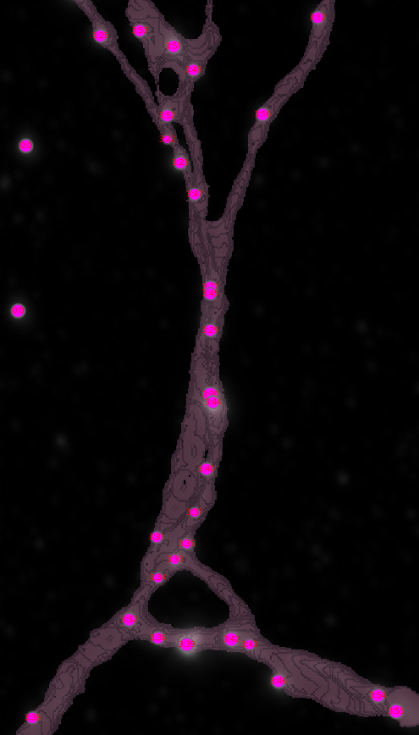
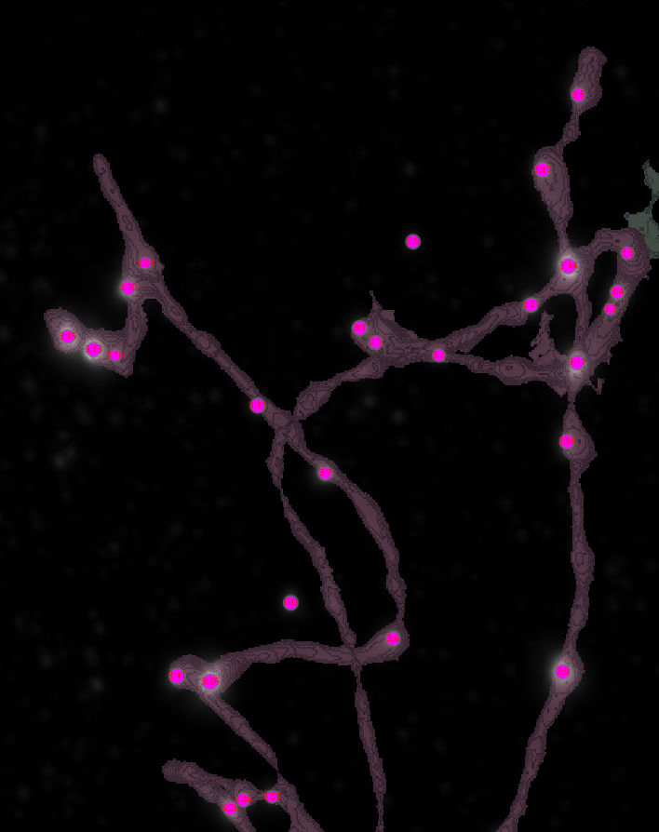
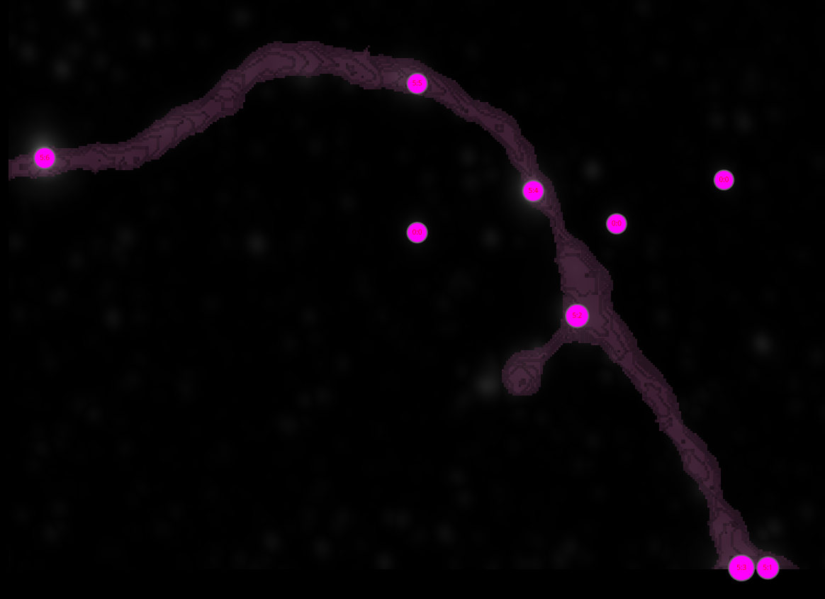
0H 3

